Slide 1
License plate recognition based on CRNN and CTC
王威虎 杨世搏 邓京雨 杨镇宇

Slide 2
01
Introduction
CONTENTS
02
Our delivery
03
Reference

Slide 3
Introduction

Slide 4
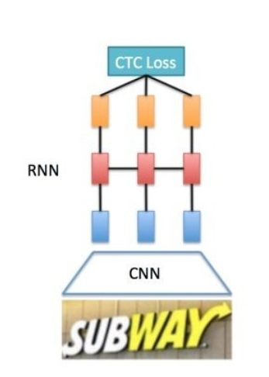
About CRNN and CTC
The CRNN(Convolutional Recurrent Neural Network) is a deep learning model that combines the advantages of CNN(Convolutional Neural Network) and RNN(Recurrent Neural Network).
Transcription Layer for converting the output of the RNN layer to text.
The CTC(Connectionist Temporal Classification) is a loss function that can be used to train the RNN model. It is widely used in the field of sequence recognition.
In this project, we use the CNN model to extract the features of the license plate image and select the area of interest, and then use the RNN model to recognize the characters in the license plate image. Finally, we use the CTC loss function to train the model.
https://arxiv.org/abs/1507.05717

Slide 5
About CRNN and CTC
Alphabet
Alphabets of CRNN model is a list of characters that can be recognized by the model.
The length of the list is 68, including 26 lowercase letters, 26 uppercase letters, 10 numbers, 6 special characters and the blank character.
The blank character is used to represent the space between characters.
alphabets = ['0', '1', '2', '3', '4', '5', '6', '7', '8', '9', 'A', 'B', 'C', 'D', 'E', 'F', 'G', 'H', 'J', 'K', 'L', 'M', 'N', 'P', 'Q', 'R', 'S', 'T', 'U', 'V', 'W', 'X', 'Y', 'Z', 'a', 'b', 'c', 'd', 'e', 'f', 'g', 'h', 'i', 'j', 'k', 'l', 'm', 'n', 'o', 'p', 'q', 'r', 's', 't', 'u', 'v', 'w', 'x', 'y', ‘z’, ‘_’]
Y = “hello”
B transform
B
Y = “-hhe-eell-l-oo”
“hello”

Slide 6
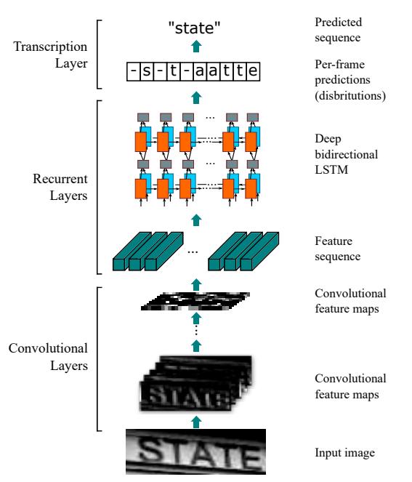
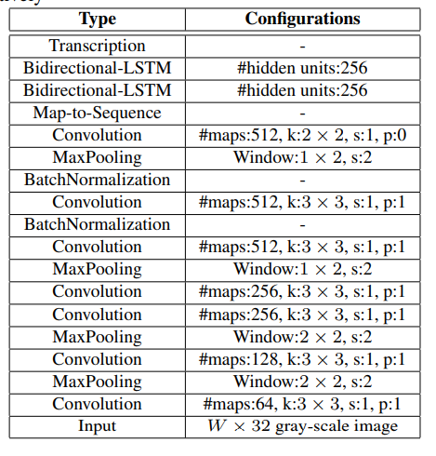
About CRNN and CTC
output
B
(25, x)
where x is length of alphabet
(25, 512)
(1, 25, 512)
(32, 100, 3)

Slide 7
Our delivery

Slide 8
Environment
Python：3.8
Pytorch：1.11.0
CUDA：11.3
CUDNN：8.0
GPU Memory：6GB

Slide 9
Data set original from CCPD
The data set used in this project is the CCPD dataset, which contains more than 300,000 license plate images.
So we need to clean the data set.
We use the following steps to clean the data set:
However, the CCPD dataset is not a standard dataset, and most of photos are token in Anhui Province, China, which causes the license plate characters starts with "皖". So we need to clean the data set. We use the following steps to clean the data set:
We uniformly selected a total of 20,000 license plate photos from different regions from all CCPD datasets.
We cropped the images of the dataset from 1st.step to an Area of Interest (AOI) and save them to a new directory.

Slide 10
Model
We use a model like ResNet50 to extract the AOI(Area of Interest) of the license plate image. The input of the model is 3-channel images, and the output is a tensor with shape(?, 4).
The CNN in CRNN consists of 10 convolutional layers, which are used to extract the features of the license plate characters.
We use deep Bidirectional-LSTM model as the RNN part to recognize the characters in the license plate image.
The CTC part is used to train the model.
Notes:
The 4 elements in the tensor represent the coordinates of the AOI. The coordinates are normalized to the range of 0 to 1. The coordinates are in the order of left, top, right, bottom.

Slide 11
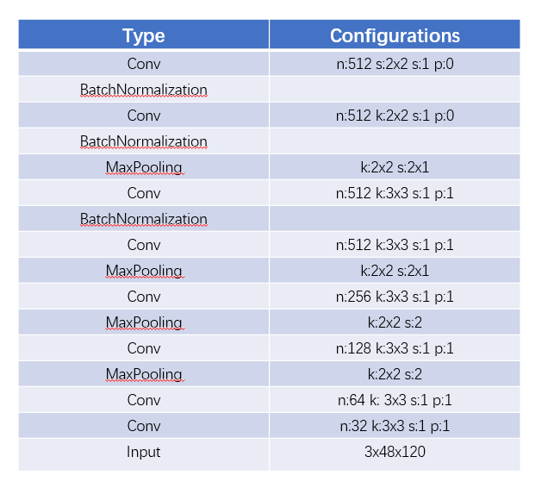
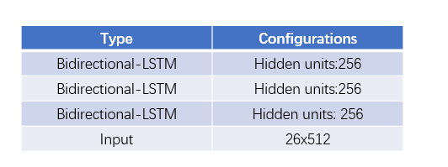
Model
The CRNN model structure is shown in the following figure:
RNN Part
CNN Part

Slide 12
Reference

Slide 13
Reference
[1] [CRNN: An End-to-End Trainable Neural Network for Image-based Sequence Recognition and Its Application to Scene Text Recognition](https://arxiv.org/abs/1507.05717)
[2] [Connectionist Temporal Classification: Labelling Unsegmented Sequence Data with Recurrent Neural Networks](https://www.cs.toronto.edu/~graves/icml_2006.pdf)
[3] [CCPD: A Large-scale Chinese Commercial License Plate Dataset](https://arxiv.org/abs/1904.01906)
[4] [Deep Residual Learning for Image Recognition](https://arxiv.org/abs/1512.03385)
[5] [VGGNet](https://arxiv.org/abs/1409.1556)
[6] [Long Short-Term Memory](https://www.bioinf.jku.at/publications/older/2604.pdf)
[7] [LSTM: A Search Space Odyssey](https://arxiv.org/abs/1503.04069)
[8] [CTC Decoder](https://distill.pub/2017/ctc/)
[9] [CTC Loss](https://distill.pub/2017/ctc/)
[10] [Pytorch](https://pytorch.org/)

Slide 14
Thanks!

